Slide 1
Buffer Overflow
Lab 9

Slide 2
Valgrind
Tool for memory debugging
Memory leaks
Use of uninitialized memory
Heap/stack buffer overrun
Profiling
AddressSanitizer is another fast memory error detector (2x vs. 20x slowdown)

Slide 3
Valgrind Example
1 #include <stdlib.h>
2
3 void f (void)
4 {
5 int* x = malloc(10 * sizeof(int));
6 x[10] = 0;
7 }
8
9 int main (void)
10 {
11 f();
12 return 0;
13 }

Slide 4
Problem 1: Heap Block Overrun
==19182== Invalid write of size 4
==19182== at 0x804838F: f (example.c:6)
==19182== by 0x80483AB: main (example.c:11)
==19182== Address 0x1BA45050 is 0 bytes after a block of size 40 alloc'd
==19182== at 0x1B8FF5CD: malloc (vg_replace_malloc.c:130)
==19182== by 0x8048385: f (example.c:5)
==19182== by 0x80483AB: main (example.c:11)

Slide 5
Problem #2: Memory Leak
==19182== 40 bytes in 1 blocks are definitely lost in loss record 1 of 1
==19182== at 0x1B8FF5CD: malloc (vg_replace_malloc.c:130)
==19182== by 0x8048385: f (example.c:5)
==19182== by 0x80483AB: main (example.c:11)

Slide 6
Lab – Steps 7 and 8
Step 7:
Use address-sanitizer (command given on lab web page)
export PATH=/usr/local/cs/bin:$PATH to get access to GCC 4.8.2
Try to crash the server in GDB
Does it help more than fstack-protector?
Step 8:
Generate assembly code for thttpd.c with -fsanitize –fstack-protector -> thttpd-sanitize.s
Compare to thttpd-stackprot.s
Which code is less efficient?

Slide 7
Lab – Step 9
Step 9:
valgrind --leak-check=yes ./thttpd –p <port number>

Slide 8
Homework Part1
Apply another patch to the server
Make web server crash on Amazon EC2
Take notes on all steps you needed to do
If you can’t make the server crash, explain the problems you encountered

Slide 9
Amazon EC2
EC2 = Elastic Compute Cloud
One of 12 AWS
Users can rent out processing power
Run a AMI in a VM in the cloud

Slide 10
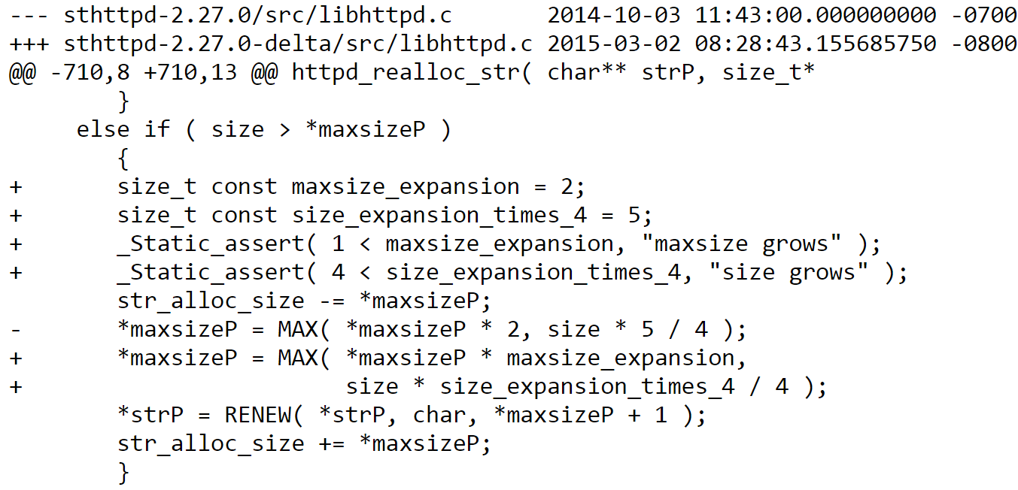
New Patch

Slide 11
Homework Part2
You are given a list of vulnerabilities
Assign an urgency score to each vulnerability

Slide 12
Things to think about…
Ease of Exploitation
Significance of Damage
Spread
Ease of repair/prevention

